Slide 1

UNIT – I
Introduction to Compiling
Topics
Introduction to Compiler
Analysis of the Source Program
Phases of a Compiler
Cousins of the Compiler
Grouping of Phases
Compiler Construction Tools
Lexical Analysis
Role of Lexical Analyzer
Input Buffering
Specification of Tokens
LEX
Compiler Design
Dept. of CSE, VFSTR University

Slide 2
Introduction
A translator inputs and then converts a source program into an object
or target program.
Source program is written in a source language
Object program belongs to an object language
A translators could be: Assembler, Compiler, Interpreter
  Assembler:
  source program object program
  (in assembly language) (in machine language)
Assembler
Compiler Design
Dept. of CSE, VFSTR University

Slide 3
Compilers
Compiler is a program which takes one language (the source language) as input and translates it into an equivalent another language (the object or target language).
During this process of translation if some errors are encountered then compiler displays them as error messages. The basic model of compiler can be represented as follows.
Input
Source
Program
Compiler
Target
Program
Error messages
Output
Compiler Design
Dept. of CSE, VFSTR University

Slide 4
Interpreters
An interpreter is another common kind of language processor. Instead of producing a target program as a translation, an interpreter appears to directly execute the operations specified in the source program on inputs supplied by the user.
The basic model of interpreter can be represented as follows.
Source
Program
Interpreter
Output
Input
Error messages
Compiler Design
Dept. of CSE, VFSTR University

Slide 5
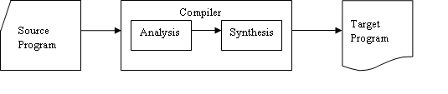
The Analysis-Synthesis Model of Compilation
There are two parts to compilation:
In analysis phase, an intermediate representation is created from the given source program.
  Lexical Analyzer, Syntax Analyzer and Semantic Analyzer are the parts of this phase.
In synthesis phase, the equivalent target program is created from this intermediate representation.
  Intermediate Code Generator, Code Generator, and Code Optimizer are the parts of this phase.
Compiler Design
Dept. of CSE, VFSTR University

Slide 6
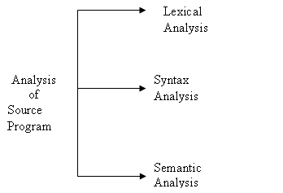
The Analysis of Source Program
The analysis part is carried out in three sub parts.
Compiler Design
Dept. of CSE, VFSTR University

Slide 7
The Analysis of Source Program
Lexical Analysis: In this step the source program is read and then it is broken into stream of strings. Such strings are called tokens. Hence tokens are nothing but the collection of characters having some meaning.
Syntax Analysis: In this step the tokens are arranged in hierarchical structure that ultimately helps in finding the syntax of the source string.
Semantic Analysis: In this step the meaning of the source string is determined.
Compiler Design
Dept. of CSE, VFSTR University

Slide 8
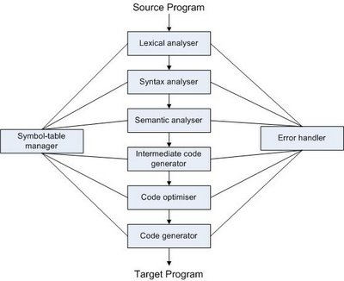
Phases of Compiler
Compiler Design
Dept. of CSE, VFSTR University

Slide 9
Lexical Analyzer
Lexical Analyzer or Linear Analyzer breaks the sentence into tokens. For Example following assignment statement :-
position = initial + rate * 60
Would be grouped into the following tokens:
1. The identifier position.
2. The assignment symbol =.
3. The identifier initial.
4. The plus sign.
5. The identifier rate.
6. The multiplication sign.
7. The number 60
Compiler Design
Dept. of CSE, VFSTR University

Slide 10
Symbol Table
position | Id1 & attributes
Initial | Id2 & attributes
rate | Id3 & attributes
An expression of the form :
Position =Initial +60*Rate
gets converted to → id1 = id2 +60*id3
So the Lexical Analyzer symbols to an array of easy to use symbolic constants (TOKENS). Also, it removes spaces and other unnecessary things like comments etc.
Compiler Design
Dept. of CSE, VFSTR University

Slide 11
Syntax Analysis
Syntax analysis is also called PARSING. It involves grouping the tokens of the source program into grammatical phrases that are used by the compiler to synthesize output. It checks the code syntax using CFG : i.e. the set of rules.
For example: if we have grammar of the form:
E = E
E = E + E
E = E * E
E = const.
Then corresponding parse tree derivation is:
E→ E = E→id = E+E→id = id + E*E→id = id + id*60
Compiler Design
Dept. of CSE, VFSTR University

Slide 12
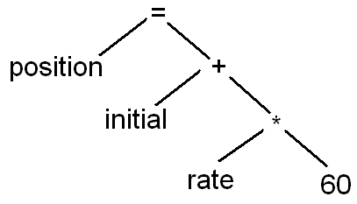
Syntax Analysis
Parser thus consumes these tokens. If any token is left unconsumed, the parser gives an error /warning.
Following is the parse tree for the taken equation:-
Compiler Design
Dept. of CSE, VFSTR University

Slide 13
Semantic Analysis
The semantic analysis phase checks source program for semantic errors and gathers type information for the subsequent code-generation phase.
In this checks are performed to ensure that the components of a program fit together meaningfully.
For example:
int a; int b;
char c[ ];
a=b + c; (Type check is done)
Compiler Design
Dept. of CSE, VFSTR University

Slide 14
Intermediate Code Generation
The intermediate representation as a program for an abstract machine.
For the example used in lexical analysis the intermediate representation will be:
temp1=int to real(60)
temp2= id3*temp1
temp3=id2+temp2
id1=temp3
Compiler Design
Dept. of CSE, VFSTR University

Slide 15
Code Optimization
The code optimization phase attempts to improves the intermediate code, so that faster-running machine code result.
The final code for example above will be:-
temp1=id3*60 // removed unnecessary
id1=id2+temp1 //variables
In “optimizing compilers”, a significant amount of time is spent on this phase. How-ever, there are simple optimizations that significantly improve the running time of the target program with out slowing down the compilation too much.
Compiler Design
Dept. of CSE, VFSTR University

Slide 16
Code Generation
The Final phase of the compiler is the generation of the target code, consisting normally of the relocatable machine code or assembly code.
Compilers may generate many types of target codes depending on M/C while some compilers make target code only for a specific M/C.
Translation of the taken code might become:
MOVF id3, R2
MULF #60.0, R2
MOVF id2, R1
ADDF R2, R1
MOVF R1, id1
Compiler Design
Dept. of CSE, VFSTR University

Slide 17
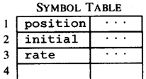
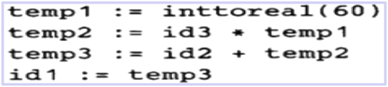

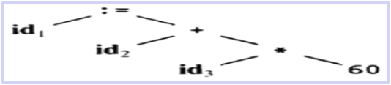

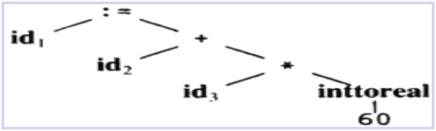
Phases Translation
Code Generator
[Intermediate Code Generator]
Non-optimized Intermediate Code
Scanner
[Lexical Analyzer]
Tokens
Code Optimizer
Parser
[Syntax Analyzer]
Optimized Intermediate Code
Parse tree
Code Optimizer
Target machine code
Semantic Process
[Semantic analyzer]
Abstract Syntax Tree w/ Attributes
Compiler Design
Dept. of CSE, VFSTR University

Slide 18
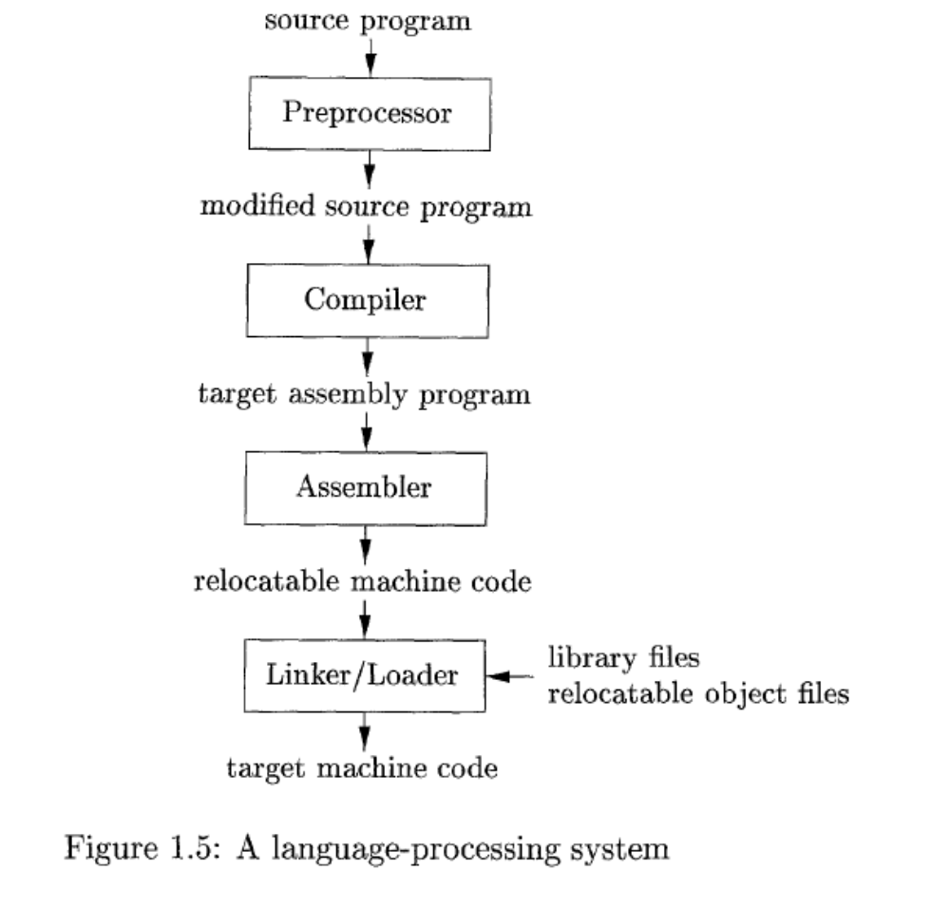
Language Processing System
Compiler Design
Dept. of CSE, VFSTR University

Slide 19
Language Processing System
Preprocessors
Pre-processing performs (usually simple) operations on the source ﬁle(s) prior to compilation. Typical pre-processing operations include:
Expanding macros (shorthand notations for longer constructs).
For example, in C,
#define foo(x,y) (3*x+y*(2+x))
deﬁnes a macro foo, that when used in later in the program, is expanded by the preprocessor. For example, a = foo(a,b) becomes
a = (3*a+b*(2+a))
(b) Inserting named ﬁles. For example, in C,
#include “header.h”
is replaced by the contents of the ﬁle header.h
Compiler Design
Dept. of CSE, VFSTR University

Slide 20
Language Processing System
Linker
A linker combines the output of the assembler for different compilations. The two primary tasks of the linker are to relocate relative addresses and to resolve external references.
Loader
A loader loads the resulting “executable file” from linker into central memory. It takes a relocatable code, alters the relocatable addresses and places the altered instructions and data in memory at proper locations.
Compiler Design
Dept. of CSE, VFSTR University

Slide 21
Cousins of the Compiler
Prprocessor
Assembler
Linker/Loader
Compiler Design
Dept. of CSE, VFSTR University

Slide 22
Grouping of Phases
Compiler front and back ends:
  Front end: analysis (machine independent)
  Back end: synthesis (machine dependent)
Compiler passes:
  A collection of phases is done only once (single pass) or multiple times (multi pass)
    Single pass: usually requires everything to be defined before being used in source program.
    Multi pass: compiler may have to keep entire program representation in memory.
Compiler Design
Dept. of CSE, VFSTR University

Slide 23
Compiler-Construction Tools
Software development tools are available to implement one or more compiler phases
  Scanner generators
  Parser generators
  Syntax-directed translation engines
  Data-flow engines
  Automatic code generators
Compiler Design
Dept. of CSE, VFSTR University

Slide 24
Compiler Construction Tool
Scanner Generators
They generate lexical analyzers automatically from the language specifications written using regular expressions. It generates a finite automaton to recognize the regular expression. An example of this tool is LEX.
Parser Generators
They produce syntax analyzers from context free grammars. As syntax analysis phase is highly complex and consumes manual and compilation time, these parser generators are highly useful. An example of this tool is YACC.
Compiler Design
Dept. of CSE, VFSTR University

Slide 25
Compiler Construction Tool
Syntax Directed Translation Engines
These engines have routines to traverse the parse tree and produce intermediate code. The basic idea is that one or more translations are associated with each node of the parse tree.
Data Flow Engines
It is used in code optimization. These tools perform good optimization using “data flow analysis” which gathers information that flows from one part of the program to another.
Compiler Design
Dept. of CSE, VFSTR University

Slide 26
Compiler Construction Tool
Automatic Code Generators
These tools convert the intermediate language into machine language for the target machine using a collection of rules. Template matching process is used. An intermediate language statement is replaced by its equivalent machine language statement.
Compiler Design
Dept. of CSE, VFSTR University

Slide 27
Lexical Analyzer
THE ROLE OF LEXICAL ANALYSER
It is the first phase of the compiler.
It reads the input characters and produces as output a sequence of tokens that the parser uses for syntax analysis.
It strips out from the source program comments and white spaces in the form of blank, tab and newline characters .
It also correlates error messages from the compiler with the source program (because it keeps track of line numbers).
Compiler Design
Dept. of CSE, VFSTR University

Slide 28
Interaction of the Lexical Analyzer with the Parser
Token,
tokenval
Source
Program
Lexical
Analyzer
Parser
Get next
token
error
error
Symbol Table
Compiler Design
Dept. of CSE, VFSTR University

Slide 29
Functions of Lexical Analyzer
It produces stream of tokens.
It eliminates blank and comments.
It generates symbol table which stores the information about identifiers, constants encountered in the input.
It keeps track of line numbers.
It reports the error encountered while generating the tokens.
Compiler Design
Dept. of CSE, VFSTR University

Slide 30
Issues in Lexical Analysis
Simpler design is perhaps the most important considerations.
Compiler efficiency is improved.
Compiler portability is enhanced.
Compiler Design
Dept. of CSE, VFSTR University

Slide 31
Tokens, Patterns, and Lexemes
Tokens: It describes the class or category of input string.
For example: identifiers, keywords, constants are called tokens.
Patterns: Set of rules that describe the token.
  For example: “letter followed by letters and digits” and “non-empty sequence of digits”
Lexemes: Sequence of characters in the source program that are matched with the pattern of the token.
  For example: abc,int,i,123
Compiler Design
Dept. of CSE, VFSTR University

Slide 32
Tokens, Patterns, and Lexemes
Token
Sample Lexemes
Informal Description of Pattern
const
if
relation
id
num
literal
const
if
<, <=, =, < >, >, >=
pi, count, D2
3.1416, 0, 6.02E23
“core dumped”
const
if
< or <= or = or < > or >= or >
letter followed by letters and digits
any numeric constant
any characters between “ and “ except “
Actual values are critical. Info is :
1. Stored in symbol table
2. Returned to parser
Classifies Pattern
Compiler Design
Dept. of CSE, VFSTR University

Slide 33
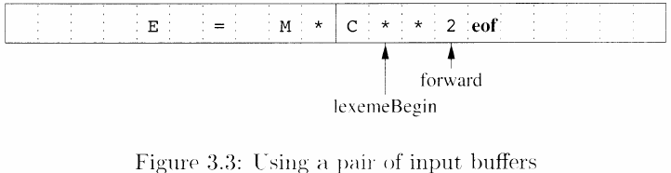
Input Buffering
Examining ways of speeding reading the source program
  In one buffer technique, the last lexeme under process will be over-written when we reload the buffer.
  Two-buffer scheme handling large look ahead safely
Compiler Design
Dept. of CSE, VFSTR University

Slide 34
Input Buffering
Buffer Pairs
Two buffers of the same size, say 4096, are alternately reloaded.
Two pointers to the input are maintained:
  Pointer lexeme_Begin marks the beginning of the current lexeme.
  Pointer forward scans ahead until a pattern match is found.
Compiler Design
Dept. of CSE, VFSTR University

Slide 35
Input Buffering
If forward at end of first half then begin
reload second half;
forward:=forward + 1;
End
Else
if forward at end of second half then begin
reload first half;
move forward to beginning of first half
End
Else forward:=forward + 1;
Compiler Design
Dept. of CSE, VFSTR University

Slide 36
Input Buffering
Sentinels
E = M * eof
C * * 2 eof eof
Compiler Design
Dept. of CSE, VFSTR University

Slide 37
Input Buffering
forward:=forward+1;
If forward ^ = EOF then begin
If forward at end of first half then begin
reload second half;
forward:=forward + 1;
End
Else if forward at end of second half then begin
reload first half;
move forward to beginning of first half
End
Else terminate lexical analysis;
Compiler Design
Dept. of CSE, VFSTR University

Slide 38

Specification of Tokens
To specify tokens regular expressions are used.
When a pattern is matched by some regular expression then token can be recognized.
Compiler Design
Dept. of CSE, VFSTR University

Slide 39
Terminology of Languages
Alphabet: a finite set of symbols .
String:
  Finite sequence of symbols on an alphabet
  Sentence and word are also used in terms of string
  ε is the empty string
  |s| is the length of string s.
Language: sets of strings over some fixed alphabet
  ∅ the empty set is a language.
  {ε} the set containing empty string is a language
  The set of well-formed C programs is a language
  The set of all possible identifiers is a language.
Operators on Strings:
  Concatenation: xy represents the concatenation of strings x and y. s ε = s ε s = s
  s^{n} ₌ s s s .. s ( n times) s⁰ ₌ ε
Compiler Design
Dept. of CSE, VFSTR University

Slide 40
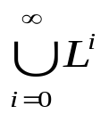

Operations on Languages
Concatenation
  L₁L₂ = { s₁s₂ | s₁ ∈ L₁ and s₂ ∈ L₂ }
Union
  L₁ ∪ L₂ = { s | s ∈ L₁ or s ∈ L₂ }
Exponentiation
  L⁰ = {ε} L¹ = L L² = LL
Kleene Closure
  L* =
Positive Closure
  L⁺ =
Compiler Design
Dept. of CSE, VFSTR University

Slide 41
Example
L₁ = {a,b,c,d} L₂ = {1,2}
L₁L₂ = {a1,a2,b1,b2,c1,c2,d1,d2}
L₁ ∪ L₂ = {a,b,c,d,1,2}
L₁³ = all strings with length three (using a,b,c,d}
L₁* = all strings using letters a,b,c,d and empty string
L₁⁺ = doesn’t include the empty string
Compiler Design
Dept. of CSE, VFSTR University

Slide 42
Regular Expressions
We use regular expressions to describe tokens of a programming language.
A regular expression is built up of simpler regular expressions (using defining rules).
Each regular expression denotes a language.
A language denoted by a regular expression is called as a regular set.
Compiler Design
Dept. of CSE, VFSTR University

Slide 43
Regular Expressions (Rules)
Regular expressions over alphabet Σ
Reg. Expr Language it denotes
ε {ε}
a∈ Σ {a}
(r₁) | (r₂) L(r₁) ∪ L(r₂)
(r₁) (r₂) L(r₁) L(r₂)
(r)* (L(r))*
(r) L(r)
(r)⁺ = (r)(r)*
(r)? = (r) | ε
Compiler Design
Dept. of CSE, VFSTR University

Slide 44
Regular Expressions (cont.)
We may remove parentheses by using precedence rules.
  * highest
  concatenation next
  | lowest
ab*|c means (a(b)*)|(c)
Ex:
  Σ = {0,1}
  0|1 => {0,1}
  (0|1)(0|1) => {00,01,10,11}
  0* => {ε ,0,00,000,0000,....}
  (0|1)* => all strings with 0 and 1, including the empty string
Compiler Design
Dept. of CSE, VFSTR University

Slide 45
Regular Definitions
To write regular expression for some languages can be difficult, because their regular expressions can be quite complex. In those cases, we may use regular definitions.
We can give names to regular expressions, and we can use these names as symbols to define other regular expressions.
A regular definition is a sequence of the definitions of the form:
d₁ → r₁ where d_{i} is a distinct name and
d₂ → r₂ r_{i} is a regular expression over symbols in
. Σ∪{d₁,d₂,...,d_{i-1}}
d_{n} → r_{n}
basic symbols previously defined names
Compiler Design
Dept. of CSE, VFSTR University

Slide 46
Regular Definitions (cont.)
Ex: Identifiers in Pascal
  letter → A | B | ... | Z | a | b | ... | z
  digit → 0 | 1 | ... | 9
  id → letter (letter | digit ) *
  If we try to write the regular expression representing identifiers without using regular definitions, that regular expression will be complex.
  (A|...|Z|a|...|z) ( (A|...|Z|a|...|z) | (0|...|9) ) *
Ex: Unsigned numbers in Pascal
  digit → 0 | 1 | ... | 9
  digits → digit ⁺
  opt-fraction → ( . digits ) ?
  opt-exponent → ( E (+|-)? digits ) ?
  unsigned-num → digits opt-fraction opt-exponent
Compiler Design
Dept. of CSE, VFSTR University

Slide 47
An Overview of Lex
Lex source program
Lex
lex.yy.c
lex.yy.c
C compiler
a.out
input
a.out
tokens
Compiler Design
Dept. of CSE, VFSTR University

Slide 48
Lex Source
Lex source is separated into three sections by %% delimiters
The general format of Lex source is
{definitions}
%%
{transition rules}
%%
{user subroutines}
(required)
(optional)
Compiler Design
Dept. of CSE, VFSTR University

Slide 49
Summary
Analysis of the Source Program
Phases of a Compiler
Cousins of the Compiler
Grouping of Phases
Compiler Construction Tools
Lexical Analysis
Role of Lexical Analyzer
Input Buffering
Specification of Tokens
LEX
Compiler Design
Dept. of CSE, VFSTR University

Slide 50
Acknowledgement
http://www.cs.fsu.edu/~engelen/courses/COP5621/
www.facweb.iitkgp.ernet.in/~niloy/COURSE/.../Compiler/ppt/intro04CS3019.ppt
Compiler Design
Dept. of CSE, VFSTR University

